Slide 1
DEFENSIVE PROGRAMMING
CITS1001

Slide 2
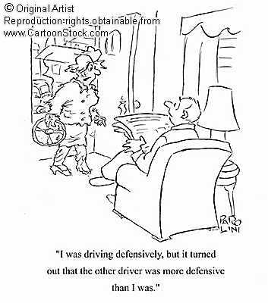
Lecture outline
Why program defensively?
Encapsulation
Access Restrictions
Documentation
Unchecked Exceptions
Checked Exceptions
Assertions

Slide 3
Why program defensively?
Normally, your classes will form part of a larger system, so other programmers will use them and rely on them
Obviously, your classes should be correct
Also importantly, your classes should be robust – resistant to accidental (or non-accidental!) misuse by other programmers
You should aim to ensure that no errors in the final system can be attributed to the behaviour of your classes
We use the terminology client code for code written by other programmers that uses your classes

Slide 4
Encapsulation
One of the most important features of OOP is that it facilitates encapsulation – a class describes both the data it uses, and the methods used to manipulate that data
The external user sees only the public methods of the class, and interacts with objects of that class purely by calling those methods
This has several benefits
Users of the class can call the public methods without needing to understand their implementation or the representation of the data
Programmers can alter or improve the implementation of the class without affecting any client code
Use and implementation are divorced

Slide 5
Access restrictions
Encapsulation is enforced by the correct use of the access modifiers on instance variables and methods
public, private, <default>, and protected
If you omit the access modifier, you get the default, sometimes known as “package”
The latter two modifiers are really only relevant for multi-package programs that use inheritance, so at the moment we need consider only public and private

Slide 6
public and private
If an instance variable is public, then
Any object can access it directly
Any object can alter it directly
If an instance variable is private, then
Objects that belong to the same class can access and alter it
Note that privacy is a per-class attribute, not per-object
If a method is public, then
Any object can call that method
If a method is private, then
Objects that belong to the same class can call it

Slide 7
Public methods
The public interface of a class is its list of public methods, which details all of the services that the class provides
Once a class is released (e.g. as part of a library), it is very difficult to change its public interface without causing problems for client code
Public methods must be precisely documented and robust to incorrect input and accidental misuse
Classes should make as few methods public as possible – limit them to just the methods needed for the class to perform its stated function

Slide 8
Public variables
Normally instance variables should not be public
If client code can alter the values of instance variables, the benefits of encapsulation are lost
If client access to instance variables is desirable, it should be provided by accessor and/or mutator methods (getters and setters)
There are two important advantages to this
Maintains object integrity
Permits change of implementation

Slide 9
A simple example
class MyDate {
public int day;
public String month;
public int year;
}
MyDate md = new MyDate();
md.day = 31;
md.month = “Feb”;
md is corrupt and could
cause problems elsewhere in the system

Slide 10
Use mutators instead
public void setDay(int day) {
// Check that day is valid for this.month
// before setting the variables
}
public int getDay() {
return this.day;
}
Setter methods act as “gatekeepers” to protect the integrity of objects
Setters reject values that would create a corrupt object
Getters return a value for client code to use, but do not allow the object itself to be changed

Slide 11
Documentation
For large systems, documentation should be developed at the same time, and in the same place, as the code
A common occurrence is that documentation is delayed until the end of the project – and it doesn’t happen!
Java provides facilities to help with this, by allowing code comments to be automatically turned into documentation
The Javadoc feature
The documentation is a contract between the programmer and the users of a class
It describes what the class is meant to do

Slide 12
Javadoc
“Normal” Java comments use two types of syntax
// comment to the end of this line
/* comment to the closing “tag” */
Javadoc comments occur between different tags
/** Javadoc comment to the closing “tag” */
Note the /** at the front!
These can be automatically processed to generate HTML documentation, used to precisely describe the behaviour of the class and its methods
The Java API itself is generated from source code comments in Javadoc

Slide 13
Javadoc comment style
Place comments directly before the relevant class, instance variable, constructor, or method
Critically important for public entities
Sometimes also useful for private entities
Comments can be written in HTML and enhanced with special Javadoc tags
e.g. @author, @version, @param, @return, @throws, @see

Slide 14
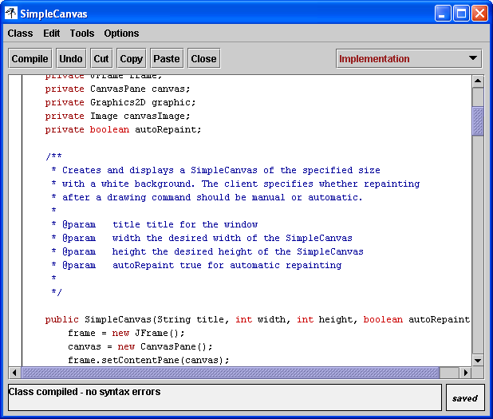
Javadoc example

Slide 15
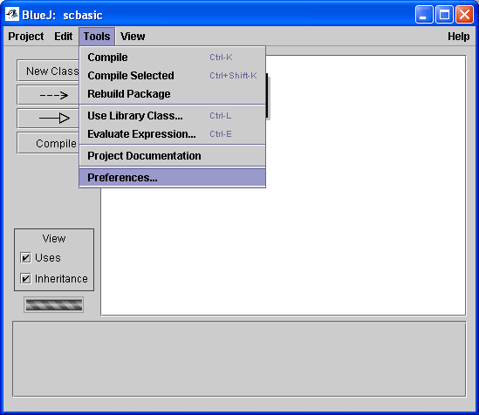
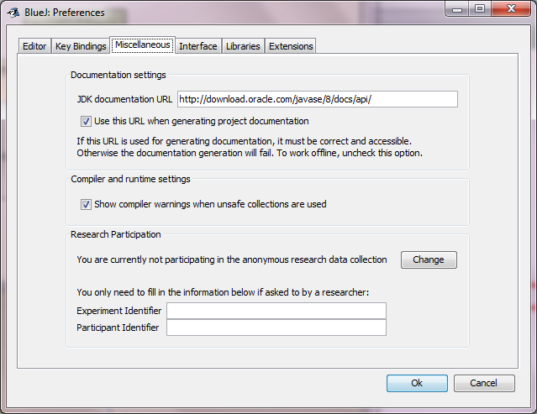
Adjust BlueJ’s preferences
Uncheck this if offline, or it will try to link to Sun’s Java documentation

Slide 16
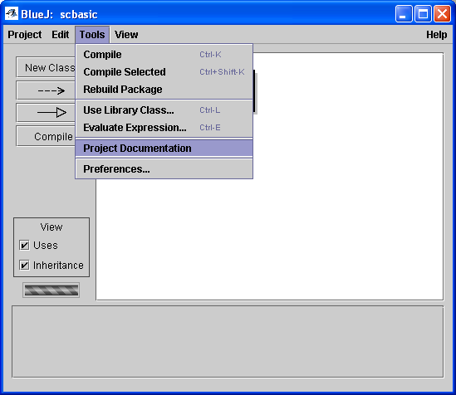
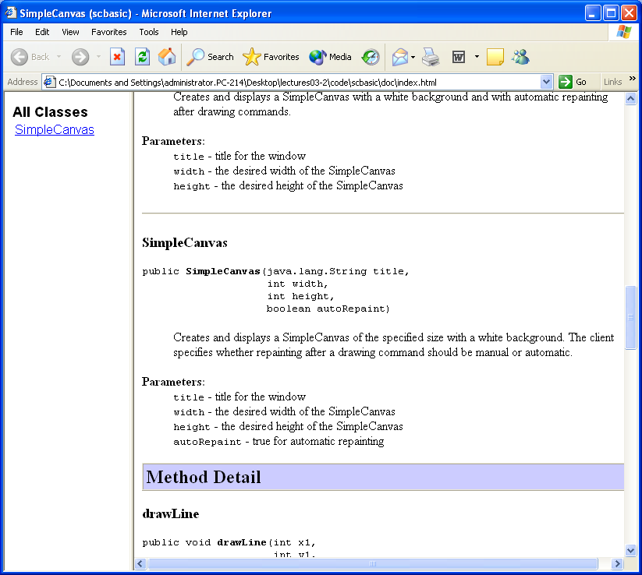
Generate documentation

Slide 17
Dealing with errors
Even if your classes are well-protected, errors will occur
We consider three types of error
Client code attempts to use your methods incorrectly, by passing incorrect or invalid parameter values
Your code cannot perform the services it is meant to, due to circumstances outside your control (such as an Internet site being unavailable)
Your own code behaves incorrectly and/or your objects become corrupted
To handle these problems, Java provides
unchecked exceptions, checked exceptions, and assertions

Slide 18
Invalid parameters
s.charAt(k) returns the character at position k in s
Valid values for k are 0 up to s.length()–1
What happens if (e.g.) s.charAt(-1) is ever called?

Slide 19
The method “throws” an exception
If a parameter is invalid, the method cannot do anything sensible with the request
It creates an object from an Exception class and “throws” it
If an Exception object is thrown, the runtime environment immediately tries to deal with it
If it is an unchecked exception, the system halts with an error message
If it is a checked exception, the system tries to find some object able to deal with it
The method charAt throws a StringIndexOutOfBoundsException
This is unchecked and hence causes the program to cease execution (i.e. to crash!)

Slide 20
Throw your own exceptions
Your own methods and/or constructors can throw exceptions if clients attempt to call them incorrectly
This is how your code can enforce rules about how methods should be used
For example, we can insist that the deposit and withdraw methods from a BankAccount class are called with positive values for the argument amount
The general mechanism is to check the parameters, and if they are invalid in some way to then
Create an object from class IllegalArgumentException
Throw that object

Slide 21
Throw your own
public BankAccount(int amount) {
if (amount >= 0) balance = amount;
else throw new IllegalArgumentException(
“Account opening balance ” +
amount + “ must be positive”);
}
If the amount is negative, create the object and throw it
The constructor for IllegalArgumentException takes a String argument which is an error message that is presented to the user
Throwing an exception is often used by constructors to prohibit the construction of invalid objects

Slide 22
“Predictable” errors
Unchecked exceptions terminate program execution, and are used when the client code is seriously wrong
Other error situations do not necessarily mean that the client code is incorrect, but reflect either a transient, predictable, or correctable mistake
This is particularly common when handling end-user input, or when dealing with the operating system
e.g. printers may be out of paper, disks may be full, web sites may be inaccessible, filenames or URLs might be mistyped, etc.

Slide 23
Checked exceptions
Methods prone to such errors may elect to throw checked exceptions, rather than unchecked exceptions
Using checked exceptions is more complicated than using unchecked exceptions in two ways
The method is required to declare that it might throw a checked exception, and
All client code using that method is required to provide code that will be run if it does throw an exception

Slide 24
The client perspective
Many Java library classes declare that they might throw a checked exception
public FileReader(File file) throws FileNotFoundException
Creates a new FileReader, given the File to read from.
Parameters:
file - the File to read from
Throws:
FileNotFoundException - if the file does not exist, if it is a directory rather than a regular file, or for some other reason it cannot be opened for reading

Slide 25
try and catch
If code uses a method that might throw a checked exception, then it must enclose it in a try/catch block
try {
FileReader fr = new FileReader(“lect.ppt”);
// code for when everything is OK
}
catch (java.io.FileNotFoundException e) {
// code for when things go wrong
}
Try to open and process this file
But be prepared to catch an exception if necessary

Slide 26
Operation of try/catch
Logically, try/catch operates a lot like if/else
If everything goes smoothly
The code in the try block is executed, and
The code in the catch block is skipped
If one of the statements in the try block causes an exception to be thrown
Execution immediately jumps to the catch block, which tries to recover from the problem
What can the catch block do?
For human users: report the error and ask the user to change their request, or retype their password, or …
In all cases: provide some feedback as to the likely cause of the error and how it may be overcome, even if ultimately it just causes execution to cease

Slide 27
Using and testing exceptions
@Test(expected = IllegalArgumentException.class)
public void testIllegalDeposit() {
BankAccount(-20);
}
Java provides many exception classes that cover most common possibilities
Exceptions are simply objects in a Java program, so you can write your own classes of exceptions if desired

Slide 28
Some useful Java exceptions
IllegalArgumentException
IndexOutOfBoundsException
NullPointerException
ArithmeticException
IOException, FileNotFoundException
Checked exceptions in Java extend the java.lang.Exception class
Unchecked exceptions extend the java.lang.RuntimeException class

Slide 29
The programmer perspective
If you write a method that throws a checked exception, this must be declared in the source code, where you must specify the type of exception that might be thrown
public void printFile(String fileName) throws
java.io.FileNotFoundException {
// Code that attempts to print the file
}
If your method declares that it might throw a checked exception, the compiler will force any client code that uses it to enclose it in a try/catch block
This explicitly makes the client code responsible for these situations
Look at FileIO for a very simple example

Slide 30
Checked or Unchecked?
Unchecked Exceptions
Any method can throw them without declaring the possibility
No need for client code to use try/catch
Causes execution to cease
Used for fatal errors that are unexpected and that are unlikely to be recoverable
Checked Exceptions
Methods must declare that they might throw them
Client code must use try/catch
Causes control flow to move to the catch block
Used for situations that are not entirely unexpected and from which clients may be able to recover
Use only if you think the client code might be able to do something about the problem

Slide 31
Assertions
Assertions are a debugging mechanism to use when you are developing complicated code
At any point in your code, add a statement of the form
assert <boolean-condition> : <string>;
When the assertion is executed, the Boolean condition is evaluated
If it is true, execution continues
If it is false, execution is halted with an (unchecked) AssertionError, and the message string is printed

Slide 32
Why use assertions?
Assertions are used to help locate logic errors
As you construct a complicated piece of code, mentally you should have a picture of what values a given variable should or could contain
Use assertions to make this picture explicit, and to have the system check it for you during execution
Otherwise an error might only become apparent a long time after the code that actually caused it, which makes it much harder to track down

Slide 33
Summary
Programming defensively means making your code robust to unexpected use
Use the need to know principle: only expose the parts of your class that client classes need to know
Java exceptions provide a uniform way of handling errors
Exceptions may be checked or unchecked
Assertions provide a way of checking whether your program is executing as expected

